Slide 1


Slide 2


Slide 3


Slide 4


Slide 5


Slide 6


Slide 7

MÚSICA MAESTRO
Luz Marina’s Studio
(306) 554-3345

Slide 8


Slide 9
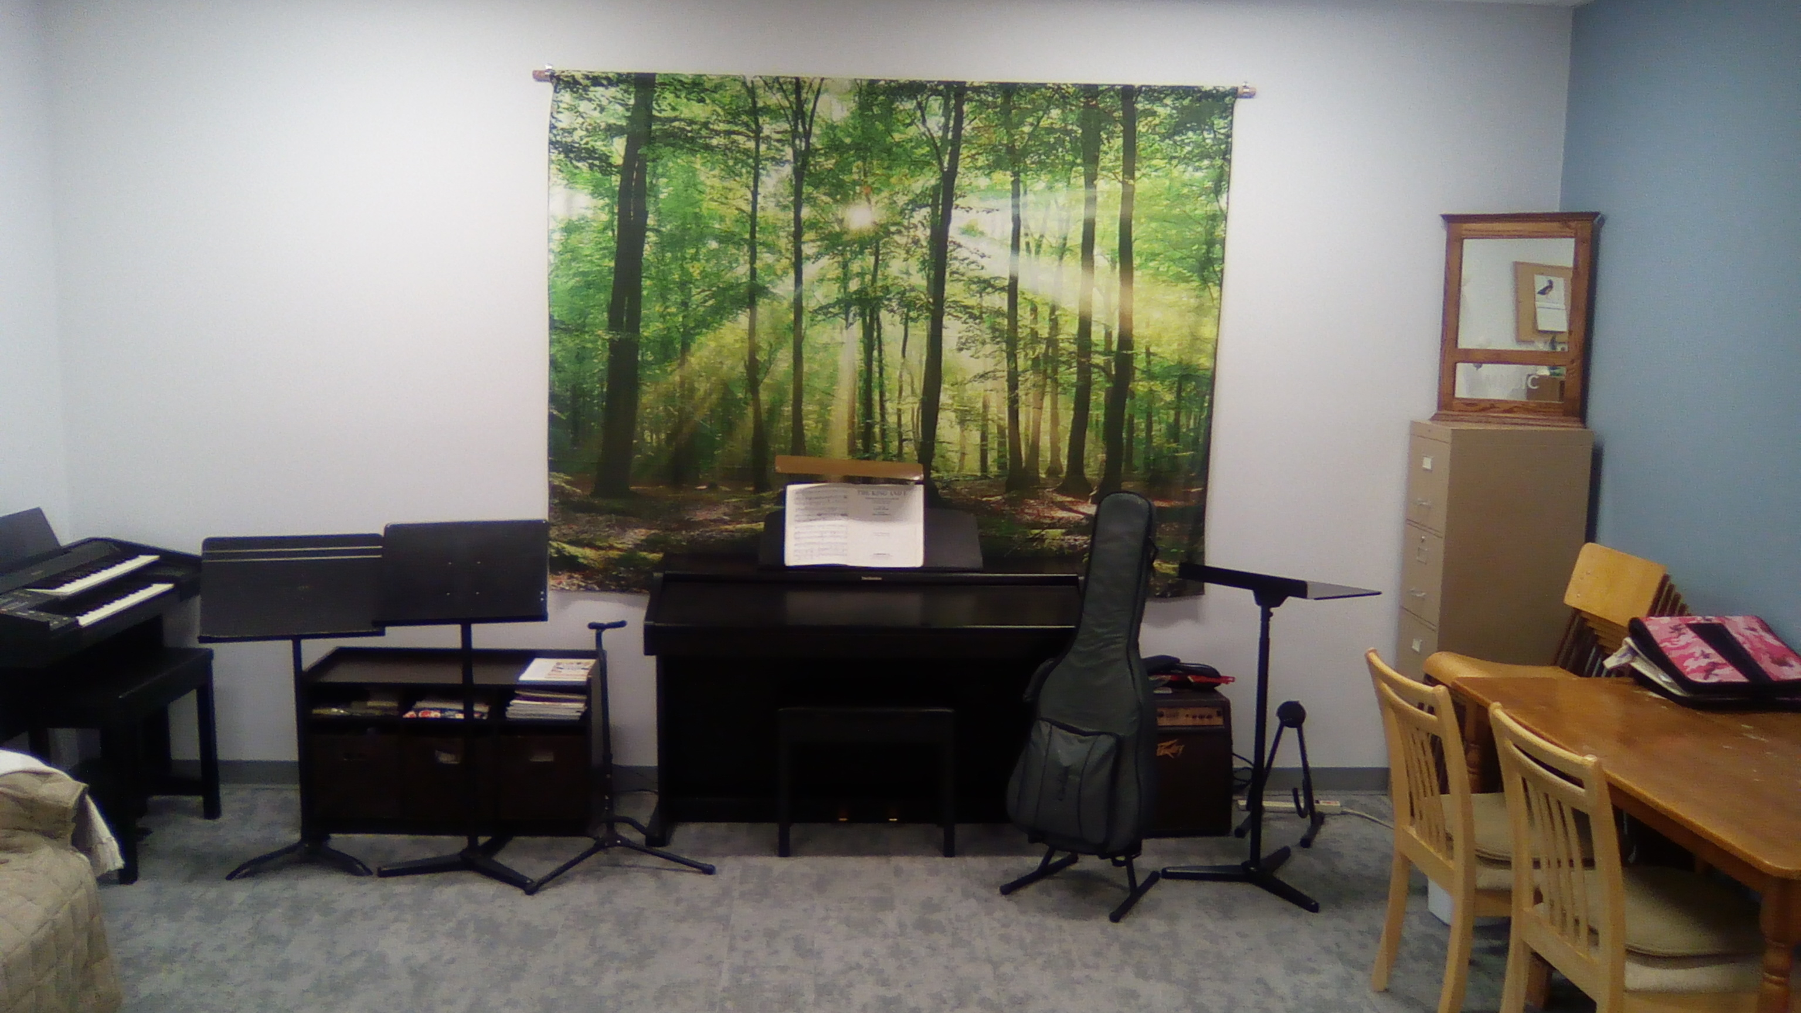

Slide 10
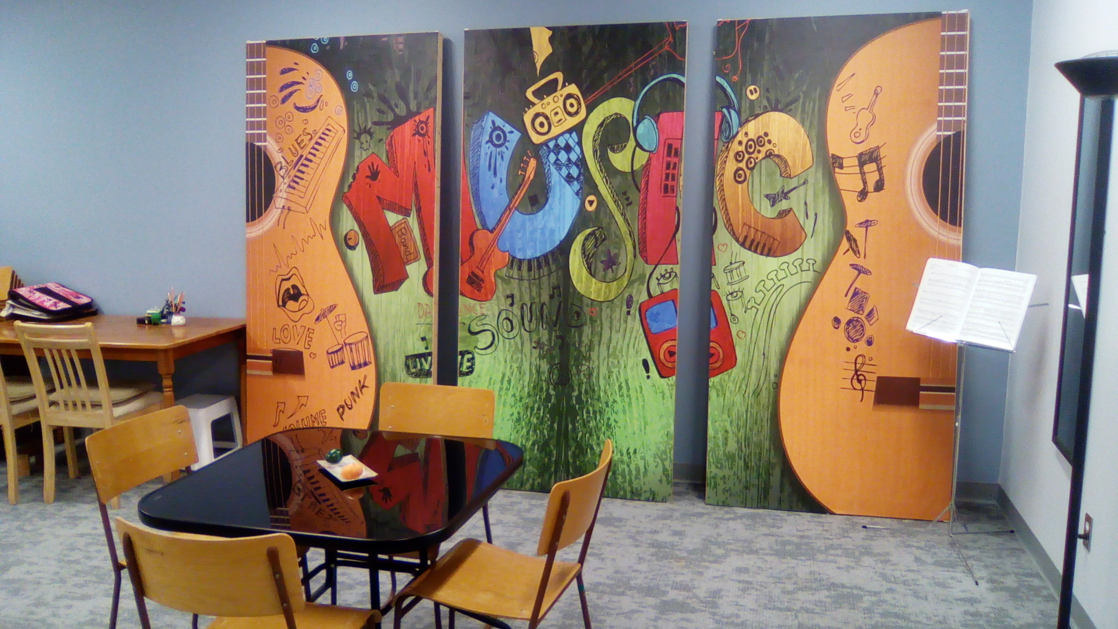

Slide 11


Slide 12


Slide 13
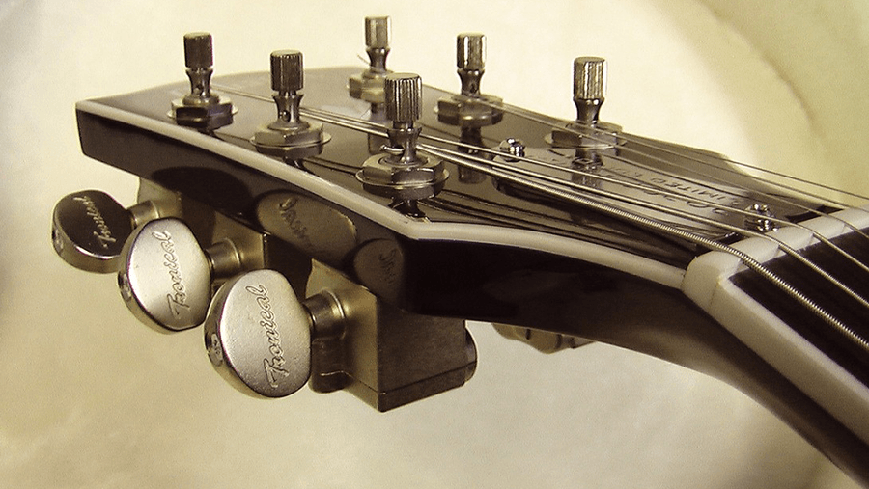

Slide 14
WE ARE MAKING SOME IMPROVEMENTS IN THIS WEBSITE TO IMPROVE YOUR EXPERIENCE.

Slide 15


